Slide 1
GBfoods
Market segregation
and sorting
A nationwide proposal for GBfoods
BTL AFRICA September 2026

Slide 2
01
The opportunity
Our understanding of the assignment and the stock-control outcome we will deliver.
02
Notes:
Content: GBfoods invitation supplied by client and GBfoods Market Segregation Proposal dated 28 September 2026. Staffing, timing and rates are proposed assumptions, subject to approval.

Slide 3

INTRODUCTION
The assignment
50+
distributor locations across Ghana
All designated GBfoods SKUs
Priority focus on Gino and Pomo Tomato Mix
Trained crews to separate affected stock, support recovery and reconcile every depot.
03
Notes:
Content: GBfoods invitation supplied by client and GBfoods Market Segregation Proposal dated 28 September 2026. Staffing, timing and rates are proposed assumptions, subject to approval.
Product photograph: https://www.gino.com.gh/ asset https://gbprodginoghcdnstorage.azureedge.net/files/2024/05/Gino_tomato_mix_packshot.png . Packaging shown for brand context.

Slide 4
VISION
Our vision for this initiative
A distributor network
where stock status
is clear at every depot
Saleable stock protected. Suspect stock controlled.
Consumer confidence preserved.
04
Notes:
Content: GBfoods invitation supplied by client and GBfoods Market Segregation Proposal dated 28 September 2026. Staffing, timing and rates are proposed assumptions, subject to approval.

Slide 5
MISSION
Our mission
To give GBfoods control
over every stock decision
01
02
03
Deploy prepared teams
Separate and record
Close with evidence
People who understand the products, the process and their responsibilities.
Clear stock zones and traceable quantities by SKU and batch.
Signed reconciliation and a named owner for every outstanding action.
05
Notes:
Content: GBfoods invitation supplied by client and GBfoods Market Segregation Proposal dated 28 September 2026. Staffing, timing and rates are proposed assumptions, subject to approval.

Slide 6
02
Our strategy
National coordination, direct field supervision and evidence at every depot.
06
Notes:
Content: GBfoods invitation supplied by client and GBfoods Market Segregation Proposal dated 28 September 2026. Staffing, timing and rates are proposed assumptions, subject to approval.

Slide 7
STRATEGY
The strategy
01
02
03
04
Risk first
Local deployment
Close supervision
Proof at closure
Prioritise affected stock and urgent quality concerns agreed with GBfoods.
Cluster ready depots to protect working time and limit avoidable travel.
One QC person per distributor, with one supervisor for each five distributors.
Reconcile quantities and retain evidence before closing a depot.
07
Notes:
Content: GBfoods invitation supplied by client and GBfoods Market Segregation Proposal dated 28 September 2026. Staffing, timing and rates are proposed assumptions, subject to approval.

Slide 8
STRATEGY
The delivery journey
PRE
DURING
POST
Prepare the network
Control the stock
Close the assignment
Validate depot data, train crews, agree routes and test the method.
Inspect, segregate, record and escalate under GBfoods quality authority.
Resolve variances, confirm custody and submit the national report.
Three stages with approval gates: readiness approval, pilot acceptance and final closeout.
08
Notes:
Content: GBfoods invitation supplied by client and GBfoods Market Segregation Proposal dated 28 September 2026. Staffing, timing and rates are proposed assumptions, subject to approval.

Slide 9
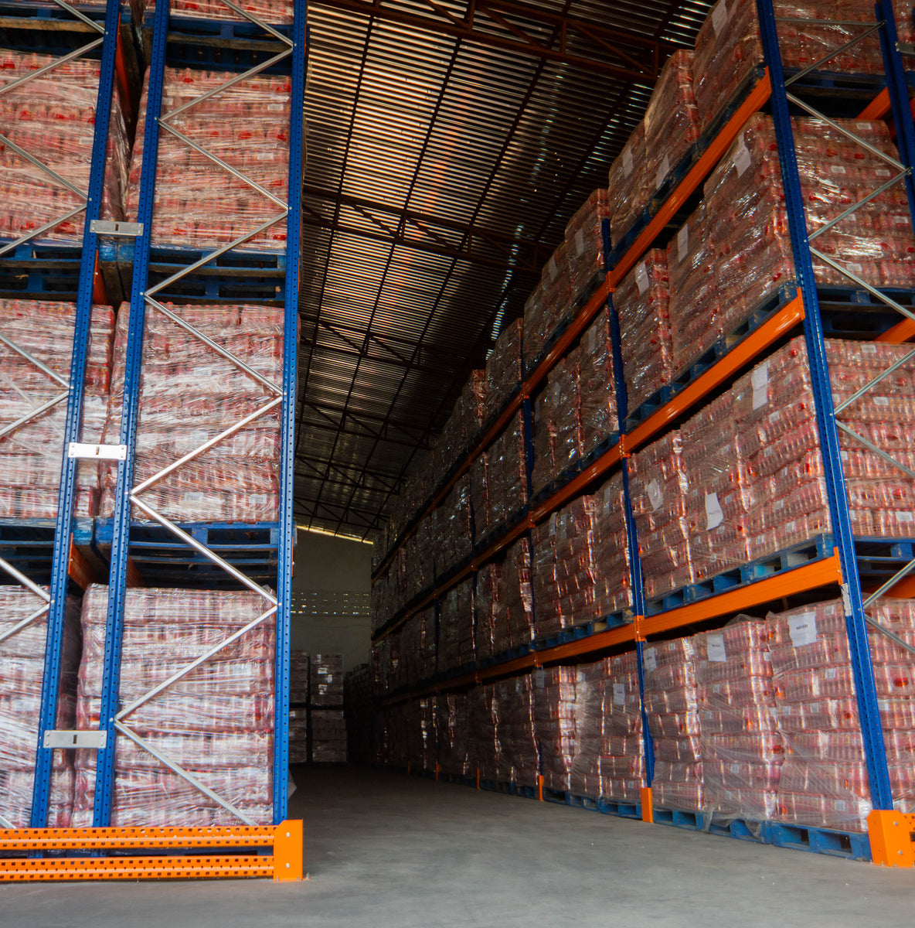
03
Pre work
A prepared depot and a trained team make the field day productive.
09
Notes:
Content: GBfoods invitation supplied by client and GBfoods Market Segregation Proposal dated 28 September 2026. Staffing, timing and rates are proposed assumptions, subject to approval.
Photo: https://rafimex.com/
Reference logistics photograph. Does not depict BTL Africa personnel or this GBfoods assignment.

Slide 10
PRE WORK
The readiness checklist
Depot intelligence
Recce confirms GPS, access, contacts, workspace and stock by SKU and batch.
A shared quality standard
Approved defect guide, handling rules and named GBfoods decision maker.
People and equipment
Assessed crews, T-shirts, photo ID cards, PPE and tested capture tools.
A confirmed appointment
Signed depot readiness, confirmed stock and a named depot representative.
Dispatch follows readiness approval, an agreed commercial ceiling and mobilisation terms.
10
Notes:
Content: GBfoods invitation supplied by client and GBfoods Market Segregation Proposal dated 28 September 2026. Staffing, timing and rates are proposed assumptions, subject to approval.

Slide 11
GBfoods
Depot recce before mobilisation
Regional and cluster supervisors inspect every assigned depot with the distributor representative.
Access and location
Verify the GPS pin, opening hours, contact person, travel route and vehicle access.
Stock and workspace
Estimate stock by SKU and batch. Confirm sorting space, lighting, ventilation and safe movement.
Control and connectivity
Agree secure holding zones, available PPE, power, phone signal and offline capture needs.
Readiness decision
Upload dated photos and a recce checklist. Assign each gap an owner and deadline.
Dispatch follows regional readiness sign-off. Critical access or safety gaps keep the depot on hold.
Notes:
Proposed operating approach for GBfoods Market Segregation and Sorting. Added at the user’s request on 29 September 2026. Agree training standards, depot readiness and acceptance criteria with GBfoods before deployment.

Slide 12
GBfoods
A dedicated QC person at every distributor
A regional chain of accountability supports the entire distributor network.
1 QC person
Assigned to each distributor for inspection, evidence capture and reconciliation.
1 cluster supervisor
For every five distributors, within the same region.
1 regional supervisor
For each region, coordinating all cluster supervisors.
National leadership
A National Operations Manager coordinates regional delivery.
Notes:
Staffing structure: user instruction, 29 September 2026. Distributor allocations and role holders remain subject to the approved depot register. Brand colours: GBfoods Basic Elements manual, https://www.thegbfoodservice.fi/media/mediafiles/Manual_GBfoods_BASIC_ELEMENTS.pdf (RGB 254,80,0 and 94,94,94).

Slide 13
GBfoods
National organisation chart
Operational reporting runs through regional supervisors. GBfoods retains quality disposition authority.
Project Director
National Quality Lead
National Operations Manager
Data & Platform Lead
16 Regional Supervisors
Cluster supervisors in each region
Each cluster supervisor oversees up to 5 distributors and their assigned QC persons.
Notes:
Staffing structure: user instruction, 29 September 2026. Distributor allocations and role holders remain subject to the approved depot register. Brand colours: GBfoods Basic Elements manual, https://www.thegbfoodservice.fi/media/mediafiles/Manual_GBfoods_BASIC_ELEMENTS.pdf (RGB 254,80,0 and 94,94,94).

Slide 14
GBfoods
Regional organisation chart
The same structure applies in each of Ghana’s 16 regions.
National Operations Manager
1 Regional Supervisor
Cluster Supervisor 01
Additional cluster supervisors
Distributor 01–05
1 assigned QC person at each
Next groups of up to 5 distributors
1 assigned QC person at each
Number of cluster supervisors = regional distributor count ÷ 5, rounded up.
Notes:
Staffing structure: user instruction, 29 September 2026. Distributor allocations and role holders remain subject to the approved depot register. Brand colours: GBfoods Basic Elements manual, https://www.thegbfoodservice.fi/media/mediafiles/Manual_GBfoods_BASIC_ELEMENTS.pdf (RGB 254,80,0 and 94,94,94).

Slide 15
GBfoods
Staffing numbers follow the depot register
Supervisors are calculated region by region, so each cluster stays within its region.
QC headcount
Equals the total number of distributors. 50 distributors require 50 assigned QC persons.
Cluster supervisors
Sum of each region’s distributor count divided by 5, rounded up.
Regional supervisors
16 designated regional supervisors. Activate deployment against the confirmed regional schedule.
Handling support
Size stock handlers and counting support by volume after the pilot. They do not replace assigned QC persons.
Notes:
Staffing structure: user instruction, 29 September 2026. Distributor allocations and role holders remain subject to the approved depot register. Brand colours: GBfoods Basic Elements manual, https://www.thegbfoodservice.fi/media/mediafiles/Manual_GBfoods_BASIC_ELEMENTS.pdf (RGB 254,80,0 and 94,94,94).

Slide 16
GBfoods
Distributor QC and cluster supervision
Assigned QC person
Inspect and classify under the approved SOP. Capture SKU, batch, counts, photos and GPS attendance.
Depot control
Maintain stock separation, flag defects, reconcile movements and obtain the depot handover signature.
Cluster supervisor
Oversee up to five distributors. Check attendance, review evidence, verify exceptions and organise support.
Quality escalation
QC flags the issue immediately. The supervisor verifies and escalates through the Quality Lead to GBfoods.
Notes:
Staffing structure: user instruction, 29 September 2026. Distributor allocations and role holders remain subject to the approved depot register. Brand colours: GBfoods Basic Elements manual, https://www.thegbfoodservice.fi/media/mediafiles/Manual_GBfoods_BASIC_ELEMENTS.pdf (RGB 254,80,0 and 94,94,94).

Slide 17
GBfoods
Regional and national responsibilities
Regional supervisor
Manage the regional roster, routes, coverage and unresolved exceptions. Submit a consolidated daily return.
National Operations
Coordinate all regions, reserve staff, schedules and authorised spending. Lead the daily client review.
National Quality Lead
Train and calibrate QC personnel. Audit classifications and escalate disposition decisions to GBfoods.
Data & Platform Lead
Maintain role access, evidence quality, sync monitoring and dashboard reporting. Preserve the audit trail.
Notes:
Staffing structure: user instruction, 29 September 2026. Distributor allocations and role holders remain subject to the approved depot register. Brand colours: GBfoods Basic Elements manual, https://www.thegbfoodservice.fi/media/mediafiles/Manual_GBfoods_BASIC_ELEMENTS.pdf (RGB 254,80,0 and 94,94,94).

Slide 18
GBfoods
Train-the-trainer programme
One GBfoods-approved method, taught consistently through the national and regional structure.
01
02
03
National masterclass
Regional cascade
Field reinforcement
GBfoods Quality, the National Quality Lead and Platform Lead train regional and cluster supervisors.
Certified supervisors train their assigned QC persons and stock handlers using the same guide and samples.
Cluster supervisors coach at the pilot, deliver daily refreshers and correct inconsistent practice.
Trainer approval follows a teach-back and practical assessment led by the National Quality Lead.
Notes:
Proposed operating approach for GBfoods Market Segregation and Sorting. Added at the user’s request on 29 September 2026. Agree training standards, depot readiness and acceptance criteria with GBfoods before deployment.

Slide 19
GBfoods
What every trainer must teach
A common facilitator guide, defect reference, sample records and practical exercises support each session.
Product and quality
Gino, Pomo and other assigned SKUs. Defect recognition, batch checks and the limits of field authority.
Safe stock handling
PPE, physical stock zones, lifting, contamination prevention and approved secondary repacking.
Counts and evidence
Opening counts, movements, reconciliation, pack units, batch references and clear product photos.
Platform and escalation
Photo ID attendance, GPS, offline sync, record review and the route for quality or safety concerns.
Notes:
Proposed operating approach for GBfoods Market Segregation and Sorting. Added at the user’s request on 29 September 2026. Agree training standards, depot readiness and acceptance criteria with GBfoods before deployment.

Slide 20
GBfoods
Practical assessment before deployment
Proposed training sequence: Day 1 trainer workshop, Day 2 team training, Day 3 assessment and corrections.
Demonstrate the task
Each trainee classifies sample stock, records a count and completes a handover exercise.
Prove digital readiness
Each QC person completes photo check-in, location capture, stock entry, photo upload and offline sync.
Confirm competence
The Quality Lead approves trainers. Supervisors assess teams against the same GBfoods-approved checklist.
Retrain and release
Log attendance and assessment results. Retrain and reassess gaps before adding personnel to the dispatch roster.
No deployment until the trainee demonstrates all mandatory safety, quality and recordkeeping steps.
Notes:
Proposed operating approach for GBfoods Market Segregation and Sorting. Added at the user’s request on 29 September 2026. Agree training standards, depot readiness and acceptance criteria with GBfoods before deployment.

Slide 21
GBfoods
T-shirts and photo ID for every team member
Visible project identification supports distributor confidence and controlled site access.
Branded T-shirts
Issue approved GBfoods project T-shirts before deployment. Confirm sizes and record each issue.
Photo ID cards
Display the person’s photo, full name, staff number, role and project name, with a supervisor contact.
Verified depot entry
Match the ID card to the approved roster and platform profile. Confirm photo and GPS check-in.
Daily compliance
Wear the T-shirt and visible ID throughout the visit, with required PPE. Report lost cards and remove access at exit.
GBfoods approves artwork before production. Identification supports access control and does not replace PPE.
Notes:
Proposed operating approach for GBfoods Market Segregation and Sorting. Added at the user’s request on 29 September 2026. Agree training standards, depot readiness and acceptance criteria with GBfoods before deployment.

Slide 22
PRE WORK
Route planning starts with workload
01
02
03
Rank the depots
Build corridors
Confirm dispatch
Agree urgency and estimate team-hours from volume, SKU mix and access.
Group nearby ready depots. Use local bases for distant locations.
Freeze the next-day route at 17:00 after depot confirmation by 15:00.
QC persons stay assigned to their distributors. Cluster supervisors plan visits across up to five sites.
22
Notes:
Content: GBfoods invitation supplied by client and GBfoods Market Segregation Proposal dated 28 September 2026. Staffing, timing and rates are proposed assumptions, subject to approval.
Illustrative route: city depot on Day 1, next ready depot on the outbound corridor on Day 2, further confirmed depot on Day 3. Actual sites require the depot register. Aim for no more than two hours local travel per normal day. Longer routes need a local base or approved travel allocation.

Slide 23
PRE WORK
Two pilot depots before full rollout
2
Measure
Units per team-hour, defect patterns and actual handling time.
Validate
Classification consistency, count accuracy and evidence capture.
different stock or access profiles
Approve
GBfoods accepts the method and revised forecast before rollout.
Pilot results confirm QC days, handling support and supervisor travel. Unit throughput remains subject to measurement.
23
Notes:
Content: GBfoods invitation supplied by client and GBfoods Market Segregation Proposal dated 28 September 2026. Staffing, timing and rates are proposed assumptions, subject to approval.

Slide 24
04
The field data platform
One platform for field input, evidence uploads and direct client access.
24
Notes:
Content: GBfoods invitation supplied by client and GBfoods Market Segregation Proposal dated 28 September 2026. Staffing, timing and rates are proposed assumptions, subject to approval.

Slide 25
PROPOSED PLATFORM
A shared view of every depot
FIELD
REVIEW
CLIENT
Capture at source
Validate the record
Access live progress
Personnel submit attendance, counts, stock status and photographic evidence.
Supervisors verify quantities and evidence, with a traceable review history.
GBfoods sees synchronised records and their review or approval status.
Proposed build. Offline records appear in the client view after synchronisation, with the last sync time visible.
25
Notes:
Content: GBfoods invitation supplied by client and GBfoods Market Segregation Proposal dated 28 September 2026. Staffing, timing and rates are proposed assumptions, subject to approval.

Slide 26
GBfoods / PLATFORM EXPERIENCE
Field attendance and depot access
A short mobile journey connects each person to the right depot and shift.
01
Sign in
STOCKCONTROL
08:10
STOCKCONTROL
08:10
Enter staff ID and PIN. The app opens the assigned depot and role.
Welcome, Abena
Depot check in
Photo ID + location
Assigned QC / Depot 03
Visit GH 014 / Accra depot
STAFF ID
Attendance photo
Photo preview includes retake.
Weak GPS prompts retry or supervisor review.
02
Confirm presence
BTL 0031
Camera preview opens here
Take an attendance photo and confirm the GPS location.
PIN
••••••
Take photo
03
GPS ready / Within depot radius
Start the visit
Sign in
Accuracy ±12 m Captured 08:10
A supervisor reviews exceptions before the visit proceeds.
Need help? Contact supervisor
Confirm check in
Access limited to your role
Location issue? Send for review
UI/UX concept. All names, locations and figures are illustrative.
26
Notes:
UI/UX concept with sample data. After staff ID and PIN authentication, show assigned role, team and depot. Request camera and location permission at check-in with a short explanation. Photo captured on the device, then preview and retake before submission. GPS accuracy and agreed depot radius govern location exceptions. No facial recognition assumed. GPS failure or outside-radius check-ins require an exception reason and supervisor review. Photo submission and successful check-in lead to the visit home. Offline check-in retains time and evidence, visibly pending sync. Check-out uses the same evidence flow.

Slide 27
GBfoods / PLATFORM EXPERIENCE
Stock capture and photographic evidence
Guided entry links every count and photograph to its depot, SKU and batch.
01
Identify the stock
STOCKCONTROL
08:10
STOCKCONTROL
08:10
Choose a SKU, batch and count unit. Required fields prevent incomplete submissions.
New stock record
Photo evidence
Evidence stays linked
Step 1 of 2 / Stock details
Step 2 of 2 / Record GH 014 007
PRODUCT
Pack
02
Capture evidence
Captured
Uploads show progress and retry.
Incomplete records return to the missing field.
Gino Tomato Mix
Photograph the pack, batch and defect. Preview or retake each image.
BATCH
Batch
Captured
Enter batch code
QUANTITY
UNIT
Defect
Add photo
03
Save and review
24
Cases
Offline / Saved on this device
Save offline when needed. Submit synced records to the supervisor.
Condition: Suspect / hold
Save draft
Next: add photos
Submit after sync
UI/UX concept. All names, locations and figures are illustrative.
27
Notes:
UI/UX concept. Product, batch, count unit, quantity and condition form a single record under the active visit. Use approved case-to-unit conversion factors. Capture expiry and pack size as required by SKU. Evidence includes pack, readable batch/expiry, defect and wider stock position when required. Never pre-classify stock as saleable without authorised GBfoods disposition. The example shows offline mode with a required defect photo missing. Save draft remains available, submit is disabled until required evidence is complete and uploads have synced. An upload queue offers retry and per-image progress without losing entries. The supervisor can accept the field record or return it with a comment. Corrections retain who changed what and when.

Slide 28
GBfoods / PLATFORM EXPERIENCE
The client control room
GBfoods sees synced progress, reviews evidence and records authorised quality decisions.
STOCK
CONTROL
National overview
Last sync 14:32
01 Filter
Region, depot, date and review status.
All regions
All depots
Today
Export report
Overview
32 / 50
18
6
3
02 Inspect
Depots
Depots complete
Records to review
Quality holds
Depots with sync delay
Open photos, quantities and the complete audit trail.
Stock records
Depot | Coverage | Review | Last sync
Accra 014 | Complete | Pending | 14:32
Kumasi 009 | In progress | Hold | 14:28
Tamale 006 | Complete | Reviewed | 14:21
Ho 003 | In progress | Pending | 12:05
Record GH 014 007
Exceptions
QUALITY HOLD
03 Decide
Reports
Gino Tomato Mix / 24 cases
Authorised users record a quality decision with a reason.
Photos 3 Batch DEMO 0626
GBfoods
Client reviewer
View record
Select a depot to open its records, evidence and review history.
UI/UX concept. All names, locations and figures are illustrative.
28
Notes:
Illustrative client dashboard. Figures do not represent actual operations. Default read-only client permissions allow filters, evidence viewing and export. Authorised GBfoods quality reviewers receive the decision control inside the record detail. It offers retain hold, request information or record approved disposition, with mandatory reason and confirmation. Field review acceptance is distinct from GBfoods release authority. Every decision records user, role and timestamp. Offline records enter the dashboard only after sync. Show per-depot last sync and exclude unsynced counts from reported totals. Status labels accompany colour. Client roles cannot silently edit submitted quantities.

Slide 29
PROPOSED PLATFORM
Photo ID sign in and geotagging
Named personnel profiles
Register each user with a staff ID, role and profile photograph.
Photo sign in at the depot
Capture an attendance photo, staff ID, depot ID and timestamp at check-in and check-out.
Location evidence
Record GPS coordinates and accuracy. Flag check-ins outside the agreed depot radius.
Supervisor verification
Review attendance exceptions. Retain the reason and reviewer for every correction.
Use photo verification rather than assumed facial recognition. Location capture applies to work events, not continuous tracking.
29
Notes:
Content: GBfoods invitation supplied by client and GBfoods Market Segregation Proposal dated 28 September 2026. Staffing, timing and rates are proposed assumptions, subject to approval.

Slide 30
PROPOSED PLATFORM
Product pictures linked to stock records
01
02
03
Capture
Tag and upload
Review
Photograph the pack, batch or expiry marking, defect and wider stock position.
Link images to depot, visit, SKU, batch, quantity, condition and capture time.
Validate required fields, review blurred images and log corrections before closing.
Store offline when needed. Show upload status, retry failed transfers and retain original evidence.
30
Notes:
Content: GBfoods invitation supplied by client and GBfoods Market Segregation Proposal dated 28 September 2026. Staffing, timing and rates are proposed assumptions, subject to approval.

Slide 31
PROPOSED PLATFORM
Direct client access
Client view | Information available | Action
Depot overview | Coverage, location, visit status and last sync | Filter by region or depot
Stock and evidence | SKU, batch, quantity, condition and product images | Review the supporting record
Exceptions | Variances, missing evidence and outstanding holds | Comment or request correction
Quality decisions | Held stock and review history | Authorised GBfoods users record decisions
Role-based access keeps client visibility separate from edit, approval and administration permissions.
31
Notes:
Content: GBfoods invitation supplied by client and GBfoods Market Segregation Proposal dated 28 September 2026. Staffing, timing and rates are proposed assumptions, subject to approval.

Slide 32
PROPOSED PLATFORM
Platform readiness before deployment
Build and configure
Approve forms, roles, depot master data, evidence rules and export formats.
Train the supervisors
Approved trainers teach QC persons and handlers, then record practical assessment results.
Test at the pilot depots
Verify photo sign-in, GPS accuracy, offline sync, image uploads and client access.
Approve go live
GBfoods accepts the tested workflow before nationwide field deployment begins.
Agree access security, consent, retention and support. Development, hosting and maintenance require a separate quotation.
32
Notes:
Content: GBfoods invitation supplied by client and GBfoods Market Segregation Proposal dated 28 September 2026. Staffing, timing and rates are proposed assumptions, subject to approval.

Slide 33
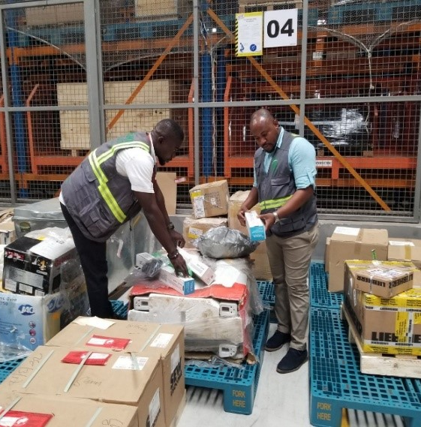
05
During work
Clear stock zones, visible supervision and a record of every movement.
33
Notes:
Content: GBfoods invitation supplied by client and GBfoods Market Segregation Proposal dated 28 September 2026. Staffing, timing and rates are proposed assumptions, subject to approval.
Photo: https://www.newsilkroadnetwork.com/news/ghanas-interest-in-the-new-silk-road-freight-consult-shares-its-growing-interactions-with-china
Reference logistics photograph. Does not depict BTL Africa personnel or this GBfoods assignment.

Slide 34
DURING WORK
Stock zones at each depot
Zone | What goes here | Control
Unexamined | Stock awaiting inspection | Record opening balance
Conforming pending release | Apparently acceptable units | GBfoods release decision
Recoverable pending approval | Intact units needing secondary repacking | Approved method and materials
Held or rejected | Suspect or quality-affected units | Secure, label and await instruction
Use physical separation and written labels. Record released stock remaining on site as a separate closing category.
34
Notes:
Content: GBfoods invitation supplied by client and GBfoods Market Segregation Proposal dated 28 September 2026. Staffing, timing and rates are proposed assumptions, subject to approval.

Slide 35
DURING WORK
A planned depot day
Time | Activity
07:00–08:30 | ID and PPE checks, travel, induction and opening count
08:30–10:30 | Sorting block 1 and initial classification check
10:45–12:45 | Sorting block 2 and supervisor review
13:30–15:30 | Sorting block 3, approved repacking and quality checks
15:30–17:00 | Reconcile, sign custody handover, return and upload
Breaks: 10:30–10:45 and 12:45–13:30. Illustrative schedule assumes a depot 30 minutes from base.
35
Notes:
Content: GBfoods invitation supplied by client and GBfoods Market Segregation Proposal dated 28 September 2026. Staffing, timing and rates are proposed assumptions, subject to approval.
Full itinerary: 07:00–07:30 briefing; 07:30–08:00 travel; 08:00–08:30 induction/count; three two-hour sorting blocks; 15:30–16:15 final reconciliation; 16:15–16:45 return; 16:45–17:00 upload. Daily progress forecast at 14:00. Unfinished stock must have a signed secured handover.

Slide 36
DURING WORK
GBfoods retains release authority
No held stock returns to sale
without authorisation
The assigned QC person oversees inspection and separation.
The cluster supervisor verifies the record.
GBfoods decides the quality disposition.
36
Notes:
Content: GBfoods invitation supplied by client and GBfoods Market Segregation Proposal dated 28 September 2026. Staffing, timing and rates are proposed assumptions, subject to approval.
Do not open, puncture, press or taste suspect packs. Repacking is limited to approved intact units and secondary packaging. No disposal, donation, sale or off-site transfer without written GBfoods instruction.

Slide 37
DURING WORK
The daily control desk
14:00
17:00
18:00
Field forecast
Dispatch plan
Client dashboard
QC persons report stock and blockers through cluster and regional supervisors.
Regional supervisors confirm routes and access with National Operations.
Coverage, stock status, variances, incidents and cost to complete.
A daily 15-minute client check-in resolves decisions. Twice-weekly reviews track progress and spend.
37
Notes:
Content: GBfoods invitation supplied by client and GBfoods Market Segregation Proposal dated 28 September 2026. Staffing, timing and rates are proposed assumptions, subject to approval.
Dashboard fields: depots planned/completed, units inspected, quantities held/recoverable/released, team-days consumed, unresolved variances, incident status, forecast completion and approved costs. Capture works offline and retains signed source records. The client dashboard updates whenever records synchronise.

Slide 38
DURING WORK
Rapid response to exceptions
Trigger | Immediate response | Decision owner
Quality or safety event | Stop the affected task and secure stock | Quality Lead + GBfoods
Count mismatch | Recount and isolate disputed quantities | Cluster supervisor
Access or crew failure | Activate a confirmed nearby alternative or reserve | Operations Manager
Excess volume or delay | Reforecast days and cost before expanding scope | Operations + GBfoods
Critical event target: immediate escalation, call within 15 minutes where possible, written record within 1 hour.
38
Notes:
Content: GBfoods invitation supplied by client and GBfoods Market Segregation Proposal dated 28 September 2026. Staffing, timing and rates are proposed assumptions, subject to approval.

Slide 39
06
Post work
A signed balance, accountable custody and a clear next action at every depot.
39
Notes:
Content: GBfoods invitation supplied by client and GBfoods Market Segregation Proposal dated 28 September 2026. Staffing, timing and rates are proposed assumptions, subject to approval.
Photo: https://rafimex.com/
Reference logistics photograph. Does not depict BTL Africa personnel or this GBfoods assignment.

Slide 40
POST WORK
The stock reconciliation
Opening + Inward − Outward
= Closing stock
SKU
BATCH
SIGN
One unit basis
One stock identity
One accountable handover
Convert cases and loose packs with approved pack factors.
Retain batch and expiry references throughout handling.
Assigned QC person, cluster supervisor and depot representative confirm the balance.
40
Notes:
Content: GBfoods invitation supplied by client and GBfoods Market Segregation Proposal dated 28 September 2026. Staffing, timing and rates are proposed assumptions, subject to approval.
Closing categories must be mutually exclusive: unexamined, conforming pending release, recoverable pending approval, held/rejected and released stock physically on site. Repacking does not alter unit quantity. Any damage or loss during handling requires a recorded incident and explicit reconciliation.

Slide 41
GBfoods
A complete handover at every depot
Completion means a verified stock record, accountable custody and a documented next action.
Signed stock balance
QC person, cluster supervisor and distributor representative confirm the reconciliation and movements.
Evidence and custody
Attach SKU and batch records, photos and location evidence. Name the custodian for every held stock quantity.
Regional verification
Regional supervisors check completeness and consolidate unresolved issues with owners and due dates.
National acceptance
Submit the national report, evidence register and financial reconciliation for GBfoods review and acceptance.
Where GBfoods accepts an open action, record its owner and due date explicitly in the final handover.
Notes:
Proposed operating approach for GBfoods Market Segregation and Sorting. Added at the user’s request on 29 September 2026. Agree training standards, depot readiness and acceptance criteria with GBfoods before deployment.

Slide 42
POST WORK
The proposed scorecard
Measure | Target | Evidence
Depot coverage | 100% completed or explicit exception | Approved depot register
Stock reconciliation | 100% signed, no unexplained variance at close | Depot reconciliation packs
Daily reporting | At least 95% by the cutoff | Timestamped daily returns
Held stock traceability | 100% with reason and custodian | Batch register and hold log
Agree productivity targets after the pilot. Report recovery rates without promising an unverified recovery percentage.
42
Notes:
Content: GBfoods invitation supplied by client and GBfoods Market Segregation Proposal dated 28 September 2026. Staffing, timing and rates are proposed assumptions, subject to approval.

Slide 43
07
Delivery and investment
The rollout programme, field cost assumptions and platform development scope.
43
Notes:
Content: GBfoods invitation supplied by client and GBfoods Market Segregation Proposal dated 28 September 2026. Staffing, timing and rates are proposed assumptions, subject to approval.

Slide 44
DELIVERY PLAN
A proposed 15 working day programme
Window | Activity | Approval or output
Days 1–3 | Trainer workshop, team training and assessment | Certified roster, IDs, PPE and approved routes
Day 4 | Two depot pilots | Measured capacity and quality review
Days 5–12 | Staggered national execution | Accepted pilot and daily depot packs
Days 13–14 | Reconciliation and authorised corrections | Resolved records and exception list
Day 15 | National review and financial closeout | Final acceptance or agreed open actions
Recce and platform readiness precede Day 1. Confirm the 15-day window after pilot results and regional allocation.
44
Notes:
Content: GBfoods invitation supplied by client and GBfoods Market Segregation Proposal dated 28 September 2026. Staffing, timing and rates are proposed assumptions, subject to approval.

Slide 45
GBfoods
Investment aligned to the revised structure
Final field pricing follows confirmation of regional allocations, workload and deployment days.
The previous field ceiling
requires a revised quotation
The source estimate of GHS 352,877.50 before tax used a different crew structure. It is not the price of this revised proposal.
Price dedicated QC coverage, cluster supervision and regional supervision separately. Platform development, hosting and support remain additional.
Notes:
Staffing structure: user instruction, 29 September 2026. Distributor allocations and role holders remain subject to the approved depot register. Brand colours: GBfoods Basic Elements manual, https://www.thegbfoodservice.fi/media/mediafiles/Manual_GBfoods_BASIC_ELEMENTS.pdf (RGB 254,80,0 and 94,94,94).

Slide 46
RECOMMENDATION
The value of the proposed model
COVER
CONTROL
CLOSE
National coordination
Clear accountability
Verifiable completion
One control desk links local teams and keeps GBfoods informed.
Every distributor has an assigned QC person, supported by cluster and regional supervisors.
Every depot closes with reconciled stock and documented custody.
Recommended next step: agree the depot register, quality instructions and pilot scope to confirm the final offer.
46
Notes:
Content: GBfoods invitation supplied by client and GBfoods Market Segregation Proposal dated 28 September 2026. Staffing, timing and rates are proposed assumptions, subject to approval.

Slide 47
08
Commercial appendix
Revised staffing and deployment costing basis. Final rates follow the approved scope.
47
Notes:
Content: GBfoods invitation supplied by client and GBfoods Market Segregation Proposal dated 28 September 2026. Staffing, timing and rates are proposed assumptions, subject to approval.

Slide 48
GBfoods
People and deployment costing basis
All rates and days require commercial confirmation before mobilisation.
Assigned QC persons
Distributor count × assigned QC days × approved daily rate.
Cluster supervisors
Sum of regional clusters × approved supervisor days and rate.
Regional supervisors
16 regional roles × approved regional deployment days and rate.
National and support team
Operations, Quality, Data, stock handlers and counting support priced by approved role days.
Notes:
Staffing structure: user instruction, 29 September 2026. Distributor allocations and role holders remain subject to the approved depot register. Brand colours: GBfoods Basic Elements manual, https://www.thegbfoodservice.fi/media/mediafiles/Manual_GBfoods_BASIC_ELEMENTS.pdf (RGB 254,80,0 and 94,94,94).

Slide 49
GBfoods
Support costs and commercial controls
Deployment support
Transport and accommodation follow regional routes and approved actual requirements.
Field readiness
Recce, trainer sessions, T-shirts, photo ID, PPE and equipment follow the approved roster.
Variable allowances
Meals, repacking materials and contingency follow approved quantities and written authorisation.
Final commercial offer
Present direct costs, management fee, contingency and tax separately. Quote platform costs separately.
Notes:
Staffing structure: user instruction, 29 September 2026. Distributor allocations and role holders remain subject to the approved depot register. Brand colours: GBfoods Basic Elements manual, https://www.thegbfoodservice.fi/media/mediafiles/Manual_GBfoods_BASIC_ELEMENTS.pdf (RGB 254,80,0 and 94,94,94).

Slide 50
COST APPENDIX
Assumptions and commercial controls
Deployment basis
50+ distributors. Dedicated QC coverage, clusters of up to five, and one supervisor per region. Confirm days and allocations.
Conditional allowances
Pay accommodation and materials against approved actuals. Release contingency only in writing.
Scope boundaries
GBfoods provides stock access and quality authority. Disposal, testing, haulage and primary reprocessing are excluded.
Proposed payment
40% on mobilisation, 40% at half the approved workload, reconciled balance at acceptance.
50
Notes:
Content: GBfoods invitation supplied by client and GBfoods Market Segregation Proposal dated 28 September 2026. Staffing, timing and rates are proposed assumptions, subject to approval.
Additional standard team-day: GHS 1,600 crew + 900 transport + 600 subsistence = 3,100 direct, or 3,410 including 10% fee, before tax, lodging, materials and additional supervision. Field supervision sits within each eight-person crew. No separate area-supervisor cost remains. Central travel and platform costs excluded pending scope and route approval. Two pilot team-days included in 60. Drivers excluded from eight-person crew. Final rates, terms and taxes require confirmation.

Slide 51
REGIONAL APPENDIX
Regional organisation charts
One regional supervisor
Clusters of up to five distributors
One QC person per distributor

Slide 52
GBfoods
Regional Breakdown
Regional reporting structure. Distributor names and allocations follow the approved register.
National Operations Manager
Greater Accra
Regional Supervisor
Cluster Supervisor
Distributor 1
1 QC person
Distributor 2
1 QC person
Distributor 3
1 QC person
Distributor 4
1 QC person
Distributor 5
1 QC person
Repeat this cluster for every additional group of up to 5 distributors in Greater Accra.
Notes:
Staffing structure: user instruction, 29 September 2026. Distributor allocations and role holders remain subject to the approved depot register. Brand colours: GBfoods Basic Elements manual, https://www.thegbfoodservice.fi/media/mediafiles/Manual_GBfoods_BASIC_ELEMENTS.pdf (RGB 254,80,0 and 94,94,94).

Slide 53
GBfoods
The decisions that start mobilisation
A joint mobilisation meeting turns the approved proposal into an agreed deployment plan.
Confirm the network
Approve distributor names, regional allocations, site contacts, access and stock scope.
Agree the standards
Approve defect guidance, disposition authority, recce criteria and the training assessment checklist.
Authorise resources
Confirm personnel, T-shirt and ID artwork, PPE, platform scope and the final commercial offer.
Release the pilot
Accept depot readiness, trained rosters and platform testing. Agree pilot dates and the rollout approval gate.
Notes:
Proposed operating approach for GBfoods Market Segregation and Sorting. Added at the user’s request on 29 September 2026. Agree training standards, depot readiness and acceptance criteria with GBfoods before deployment.

Slide 54
GBfoods
Every distributor covered.
Every stock decision recorded.
A trained team. Clear supervision.
A verified handover.
Thank you
BTL AFRICA
Notes:
Closing proposition. Delivery scope and timing remain subject to the approved depot register, recce readiness, trained personnel, pilot acceptance and commercial agreement.

